Slide 1


AIR PURIFIER DEVELOPMENT
PRESENTATION
ARUNABHA BHATTACHARYYA

Slide 2
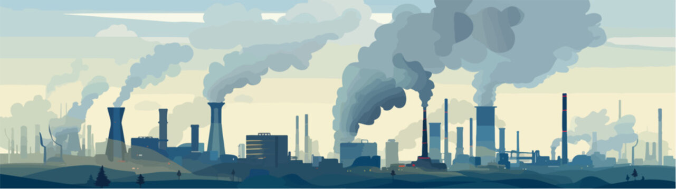
AIR POLLUTION
INDIA
Air pollution in India is a serious environmental and health issue caused by emissions from vehicles, industries, burning of crop residue, and construction dust. Major cities like Delhi, Mumbai, and Kolkata often experience hazardous levels of pollutants such as PM2.5 and PM10, which harm respiratory and cardiovascular health. Seasonal factors, like winter temperature inversions, worsen pollution. Efforts to reduce pollution include stricter emission norms, promoting cleaner fuels, and increasing green cover, but challenges remain due to rapid urbanization and population growth.

Slide 3
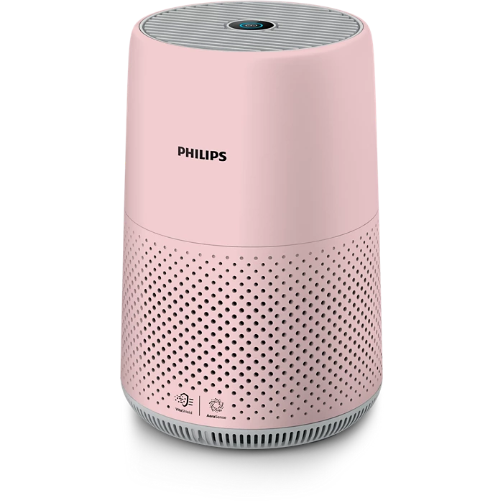
WHAT IS
AIR PURIFIER
Air purifiers are vital in today’s polluted environment, especially in cities with deteriorating air quality. They filter out harmful pollutants like PM2.5, VOCs, and allergens, protecting our lungs and boosting overall health. Innovations now focus on smart sensors, localized pollution mapping, and energy-efficient filtration. As awareness rises, air purifiers are becoming a necessity, not a luxury—crucial for healthier indoor living.

Slide 4
PRIMARY ANALYSIS
1. List the top 5 and bottom 5 areas with highest average AQI. (Consider areas which contains data from last 6 months: December 2024 to May 2025)
2. List out top 2 and bottom 2 prominent pollutants for each state of southern India. (Consider data post covid: 2022 onwards)
3. Does AQI improve on weekends vs weekdays in Indian metro cities (Delhi, Mumbai, Chennai, Kolkata, Bengaluru, Hyderabad, Ahmedabad, Pune)? (Consider data from last 1 year)
4. Which months consistently show the worst air quality across Indian states — (Consider top 10 states with high distinct areas)
5. For the city of Bengaluru, how many days fell under each air quality category (e.g., Good, Moderate, Poor, etc.) between March and May 2025?
6. List the top two most reported disease illnesses in each state over the past three years, along with the corresponding average Air Quality Index (AQI) for that period.
7. List the top 5 states with high EV adoption and analyse if their average AQI is significantly better compared to states with lower EV adoption

Slide 5
SECONDARY SKILL
1. Which age group is most affected by air pollution-related health outcomes — and how does this vary by city?
2. Who are the major competitors in the Indian air purifier market, and what are their key differentiators (e.g., price, filtration stages, smart features)?
3. What is the relationship between a city’s population size and its average AQI — do larger cities always suffer from worse air quality? (Consider 2024 population and AQI data for this)
4. How aware are Indian citizens of what AQI (Air Quality Index) means — and do they understand its health implications?
5. Which pollution control policies introduced by the Indian government in the past 5 years have had the most measurable impact on improving air quality — and how have these impacts varied across regions or cities?

Slide 6




TOOLS USED

Slide 7
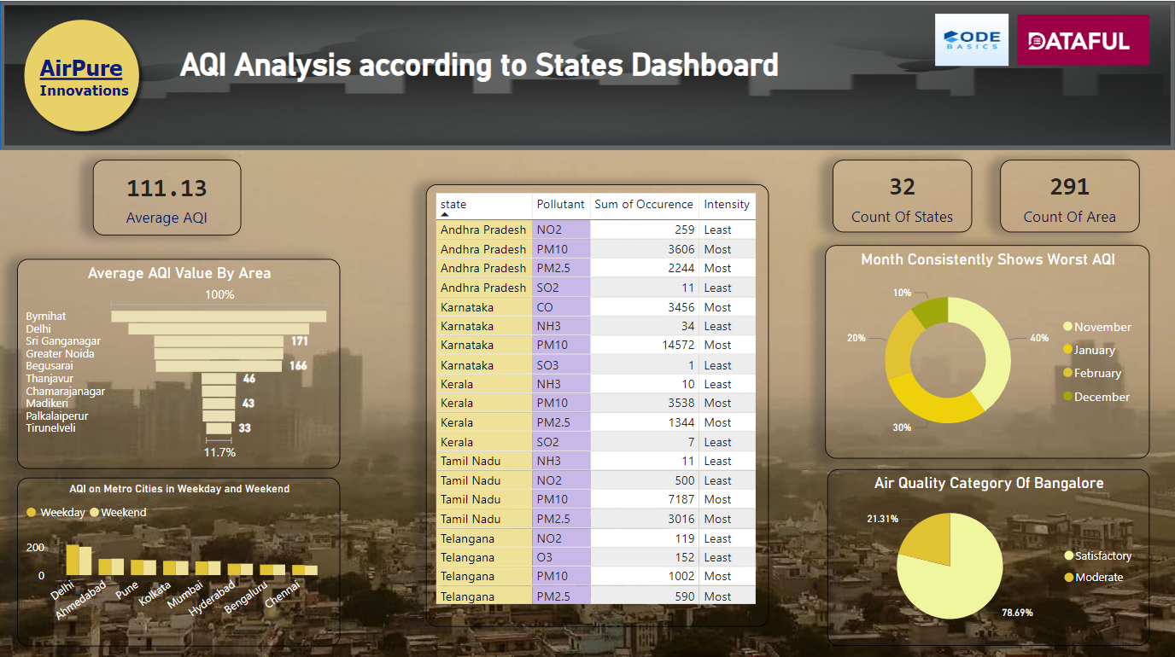

Slide 8
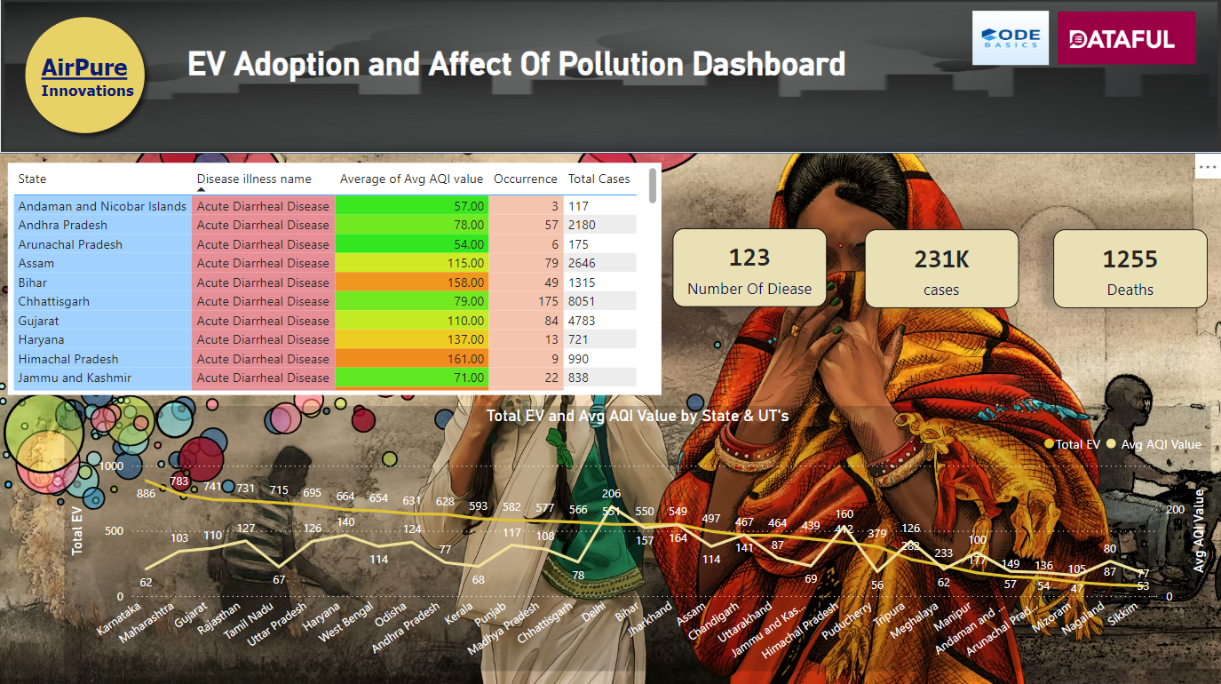

Slide 9
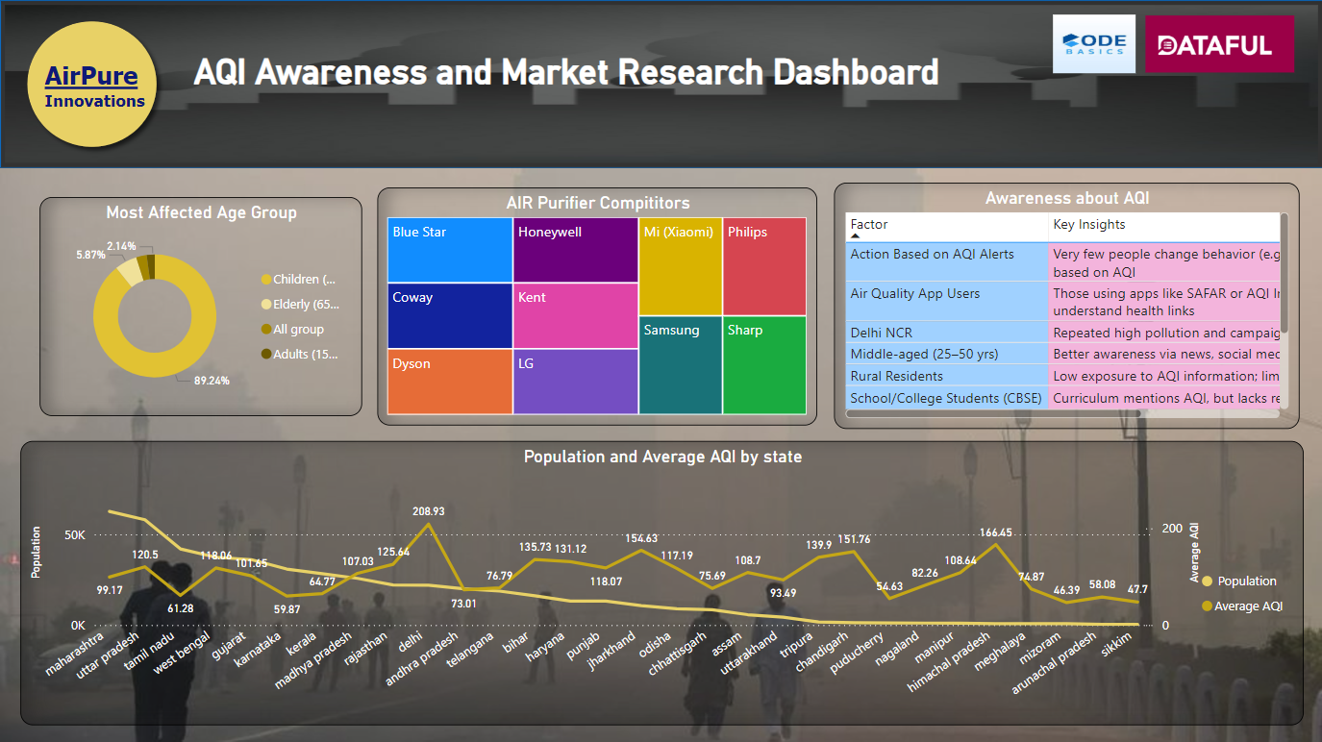

Slide 10
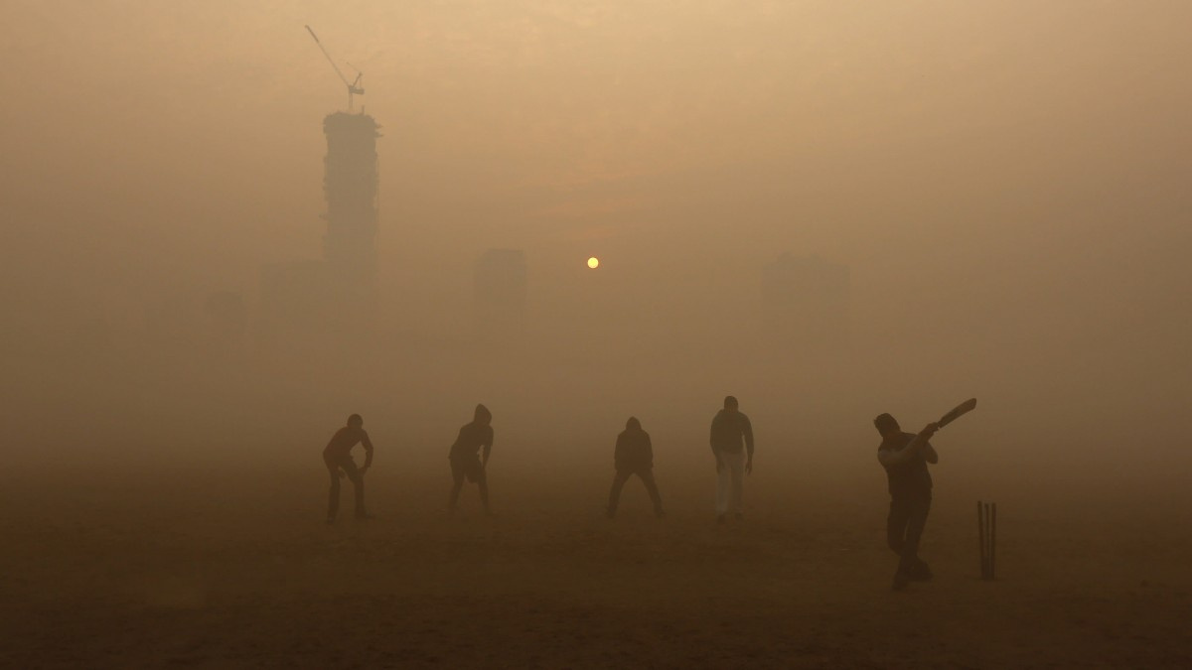
RECOMMENDATION
North India
States Covered: Delhi, Haryana, Uttar Pradesh, Punjab, Bihar, Himachal Pradesh AQI Range: 140–207 (Very High Pollution Levels)
Recommended Product Features:
Medical-grade HEPA H13/H14 filters capable of capturing PM2.5 and PM10 particles.
Activated carbon filters to remove smoke, sulfur dioxide (SO₂), nitrogen dioxide (NO₂), and unpleasant odors.
Real-time AQI display with LED indicators and mobile synchronization.
Safety features including Child Lock and Auto Mode for family protection.
High Clean Air Delivery Rate (CADR) designed for large urban rooms.

Slide 11
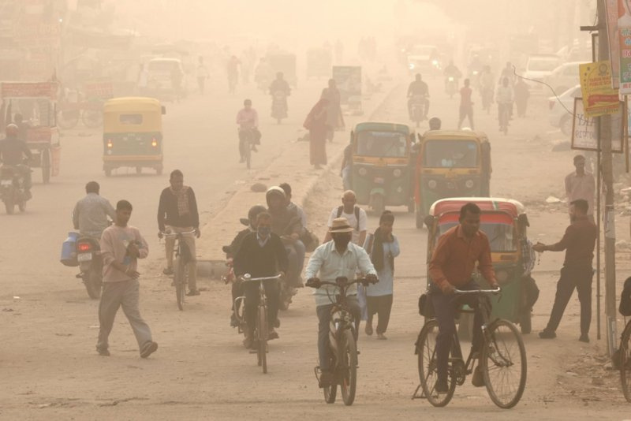
RECOMMENDATION
South India
States Covered: Karnataka, Tamil Nadu, Kerala, Telangana, Andhra Pradesh AQI Range: Mostly below 100 (Moderate to Clean Air)
Recommended Product Features:
UV-C sterilization technology for killing airborne bacteria and viruses.
Anti-allergen filters targeting mold spores and dust mites.
Silent/Night mode suitable for bedrooms and children’s rooms.
Smart app control with WiFi connectivity, catering to tech-savvy urban households.
Energy-efficient designs aligned with the region’s growing green electric vehicle (EV) ecosystem.

Slide 12
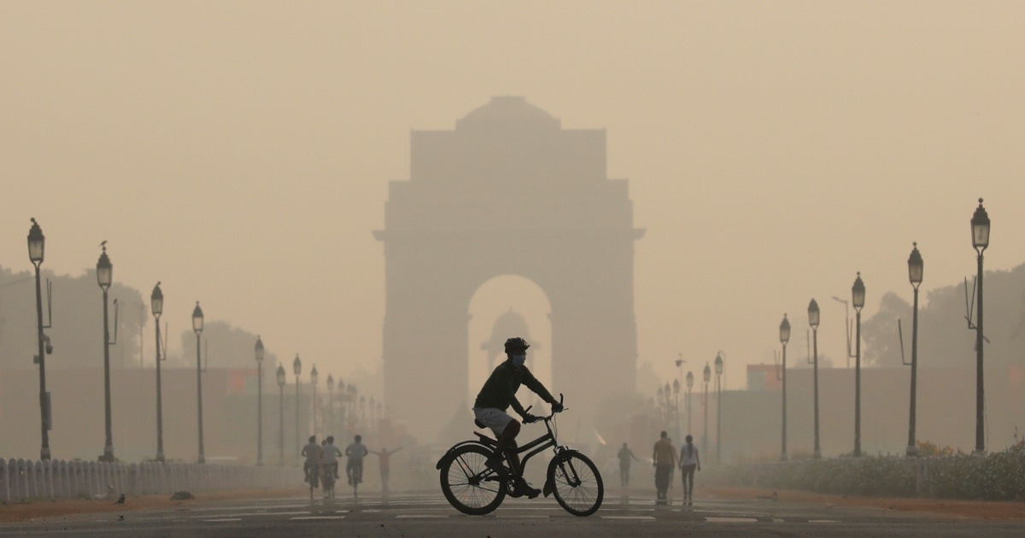
RECOMMENDATION
West India
States Covered: Maharashtra, Gujarat, Rajasthan, Goa AQI Range: 100–130 (Urban High Pollution)
Recommended Product Features:
CO-specific filtration with carbon monoxide and volatile organic compound (VOC) sensors.
Industrial-strength models suitable for kitchens, workshops, and clinics.
Dual-mode operation controlling both pollution and odors.
Sleek designs with wall-mount options ideal for space-constrained apartments.

Slide 13
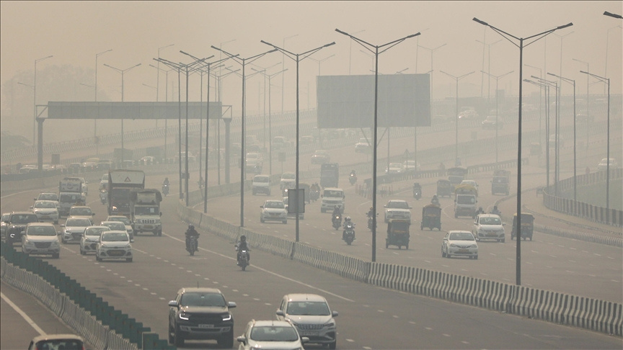
RECOMMENDATION
Eastern and Central India
States Covered: Odisha, West Bengal, Assam, Jharkhand, Chhattisgarh, Bihar AQI Range: 115–150 (Moderate to High Pollution)
Recommended Product Features:
Multi-layer filtration systems combining dust filters, HEPA, and activated charcoal.
Low-maintenance designs featuring longer filter life and filter health indicators.
Rugged build quality and stable power consumption for mixed rural and urban environments.
Rural-specific models offering battery backup or solar-compatible options for areas with unreliable power.

Slide 14
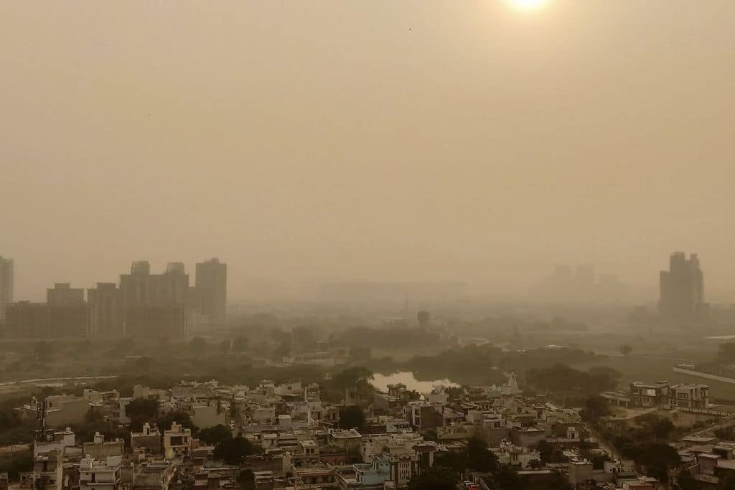
RECOMMENDATION
North-East India
States Covered: Mizoram, Manipur, Meghalaya, Tripura, Nagaland, Sikkim, Arunachal Pradesh AQI Range: 47–90 (Mostly Clean Air)
Recommended Product Features:
Filtration optimized for smoke and VOCs typical of biomass cooking exposure.
Compact and portable units suitable for smaller rooms.
Low noise and low power consumption, ideal for remote or tier-3 households.
Affordable Essential Series models targeting preventive care needs.

Slide 15
CONCLUSION
This analysis highlights the stark regional disparities in air quality across India, with North India facing very high pollution levels, while Southern and North-Eastern regions maintain comparatively cleaner air. The findings emphasize the need for tailored air purifier solutions that address specific regional pollution profiles and user requirements. Advanced filtration technologies like HEPA, activated carbon, and UV-C sterilization are essential to effectively combat particulate matter and harmful gases. Additionally, smart features such as real-time AQI monitoring and energy-efficient modes cater to evolving consumer preferences, especially in urban areas. The project underscores the importance of integrating environmental awareness with technological innovation to improve public health outcomes. Targeted interventions, informed product design, and increased public education will be critical to mitigating pollution-related risks and enhancing quality of life across India’s diverse regions.

Slide 16
THANK YOU

